Slide 1
EECS 498 System Design of a Search Engine
Winter 2026
Lecture 2: Search engine basics
Nicole Hamilton
https://web.eecs.umich.edu/~nham/
nham@umich.edu

Slide 2
Agenda
Course details
MostPositiveSubsequence
History of the web
Search basics
Your project

Slide 3
agenda
Course details
MostPositiveSubsequence
History of the web
Search basics
Your project

Slide 4
details
I’ve typed your ideas from Friday lab into the slides and posted a PDF to Canvas.
We will be doing a survey to pick a mascot for a tee shirt.
Your next homework will ask you to create a Gantt chart for a plan to apply to graduate school, due Sunday.
I’m hoping everyone can find a team this week. (More speed dating today if we have time.)
Questions?

Slide 5
details
I’ve typed your ideas from Friday lab into the slides and posted a PDF to Canvas.
We will be doing a survey to pick a mascot for a tee shirt.
OH will be every day.
your next homework will ask you to create a Gantt chart for a plan to apply to graduate school, due Sunday.
I’m hoping everyone can find a team this week. (More speed dating today if we have time.)
Questions?

Slide 6
agenda
Course details
MostPositiveSubsequence
History of the web
Search basics
Your project

Slide 7
MostPositiveSubsequence
Write a C++ function that can scan a sequence of N integers in an array A, returning the sum and the left and right indices of the most positive subsequence.
For example, for the sequence
{ -1, 3, 5, 6, -2, -4, 1, 7, -15, 12, 7, -5 }
the best sum = 20, left = 1, right = 10.

Slide 8
MostPositiveSubsequence
Was it ambiguous?
Anything not specified?

Slide 9
MostPositiveSubsequence
Was it ambiguous? Yes.
Anything not specified?
What happens if a null sequence is given? (Can you have null sequence?)
What if all the numbers are negative or zero?
Does it have to be the shortest sequence?
What if two sequences are identical?
Does performance matter?

Slide 10
what you saw
Rules you were asked to discover:
Since an empty argv was treated as a usage error, you were free to assert n > 0 in your MostPositiveSubsequence( ) function.
If all the elements are negative, the result is the single least negative element.
If two subsequences have identical sums, the shortest, leftmost is preferred.
Also, performance and code size does matter. You had to be within 20% of my benchmark and less than 50 LOC.

Slide 11
why shortest first?
Consider this as a signal processing problem, of picking the peak.
Two common characteristics of signals are that they may have harmonics and they may repeat.

Slide 12
What should you choose?

Slide 13
What should you choose?

Slide 14
What should you choose?

Slide 15
naïve solution
int NaiveSolution( int a[ ], int n, int &bestL, int &bestR )
{
assert( n );
int sum, bestSum, L, R;
bestSum = a[ 0 ];
bestL = bestR = 0;
for ( L = 0; L < n; L++ )
for ( R = L, sum = 0; R < n; R++ )
{
sum += a[ R ];
if ( sum > bestSum )
{
bestL = L;
bestR = R;
bestSum = sum;
}
}
return bestSum;
}
What makes this naïve?

Slide 16
naïve solution
int NaiveSolution( int a[ ], int n, int &bestL, int &bestR )
{
assert( n );
int sum, bestSum, L, R;
bestSum = a[ 0 ];
bestL = bestR = 0;
for ( L = 0; L < n; L++ )
for ( R = L, sum = 0; R < n; R++ )
{
sum += a[ R ];
if ( sum > bestSum )
{
bestL = L;
bestR = R;
bestSum = sum;
}
}
return bestSum;
}
What makes this naïve?
Once a sum <= 0, it can't be useful.

Slide 17
int Improved( int a[ ], int n, int &bestL, int &bestR )
{
assert( n );
int sum, bestSum, L, R;
bestSum = a[ 0 ];
bestL = bestR = 0;
for ( L = 0; L < n; L++ )
for ( R = L, sum = 0; R < n; R++ )
{
sum += a[ R ];
if ( sum > bestSum )
{
bestL = L;
bestR = R;
bestSum = sum;
}
if ( sum <= 0 )
break;
}
return bestSum;
}
Stops when the sum <= 0.
Does not find the shortest sequence.

Slide 18
int Shortest( int a[ ], int n, int &bestL, int &bestR )
{
assert( n );
int sum, bestSum, L, R;
bestSum = a[ 0 ];
bestL = bestR = 0;
for ( L = 0; L < n; L++ )
for ( R = L, sum = 0; R < n; R++ )
{
sum += a[ R ];
if ( sum > bestSum ||
sum == bestSum && R - L < bestR - bestL )
{
bestL = L;
bestR = R;
bestSum = sum;
}
if ( sum <= 0 )
break;
}
return bestSum;
}
Finds the shortest sequence.

Slide 19
int Shortest( int a[ ], int n, int &bestL, int &bestR )
{
assert( n );
int sum, bestSum, L, R;
bestSum = a[ 0 ];
bestL = bestR = 0;
for ( L = 0; L < n; L++ )
for ( R = L, sum = 0; R < n; R++ )
{
sum += a[ R ];
if ( sum > bestSum ||
sum == bestSum && R - L < bestR - bestL )
{
bestL = L;
bestR = R;
bestSum = sum;
}
if ( sum <= 0 )
break;
}
return bestSum;
}
So, what’s wrong here?
Student ticks = 5278229
Benchmark ticks = 260295
Ratio = 20.2779
Perf limit = 1.1
Performance is slow
Test has failed

Slide 20
int Shortest( int a[ ], int n, int &bestL, int &bestR )
{
assert( n );
int sum, bestSum, L, R;
bestSum = a[ 0 ];
bestL = bestR = 0;
for ( L = 0; L < n; L++ )
for ( R = L, sum = 0; R < n; R++ )
{
sum += a[ R ];
if ( sum > bestSum ||
sum == bestSum && R - L < bestR - bestL )
{
bestL = L;
bestR = R;
bestSum = sum;
}
if ( sum <= 0 )
break;
}
return bestSum;
}
Do we really need two nested loops?
Two exits to the for loop.

Slide 21
int BenchmarkSolution( int a[ ], int n, int &bestL, int &bestR )
{
assert( n );
int sum, bestSum, L, R;
bestSum = a[ 0 ];
bestL = bestR = 0;
for ( L = R = sum = 0; R < n; R++ )
{
sum += a[ R ];
if ( sum > bestSum ||
sum == bestSum && R - L < bestR - bestL )
{
bestL = L;
bestR = R;
bestSum = sum;
}
if ( sum <= 0 )
{
sum = 0;
L = R + 1;
}
}
return bestSum;
}
Can this be improved?
Yes, you could move the increment.
Student ticks = 251726
Benchmark ticks = 260461
Ratio = 0.966463
Perf limit = 1.1
Performance is okay
Test succeeded

Slide 22
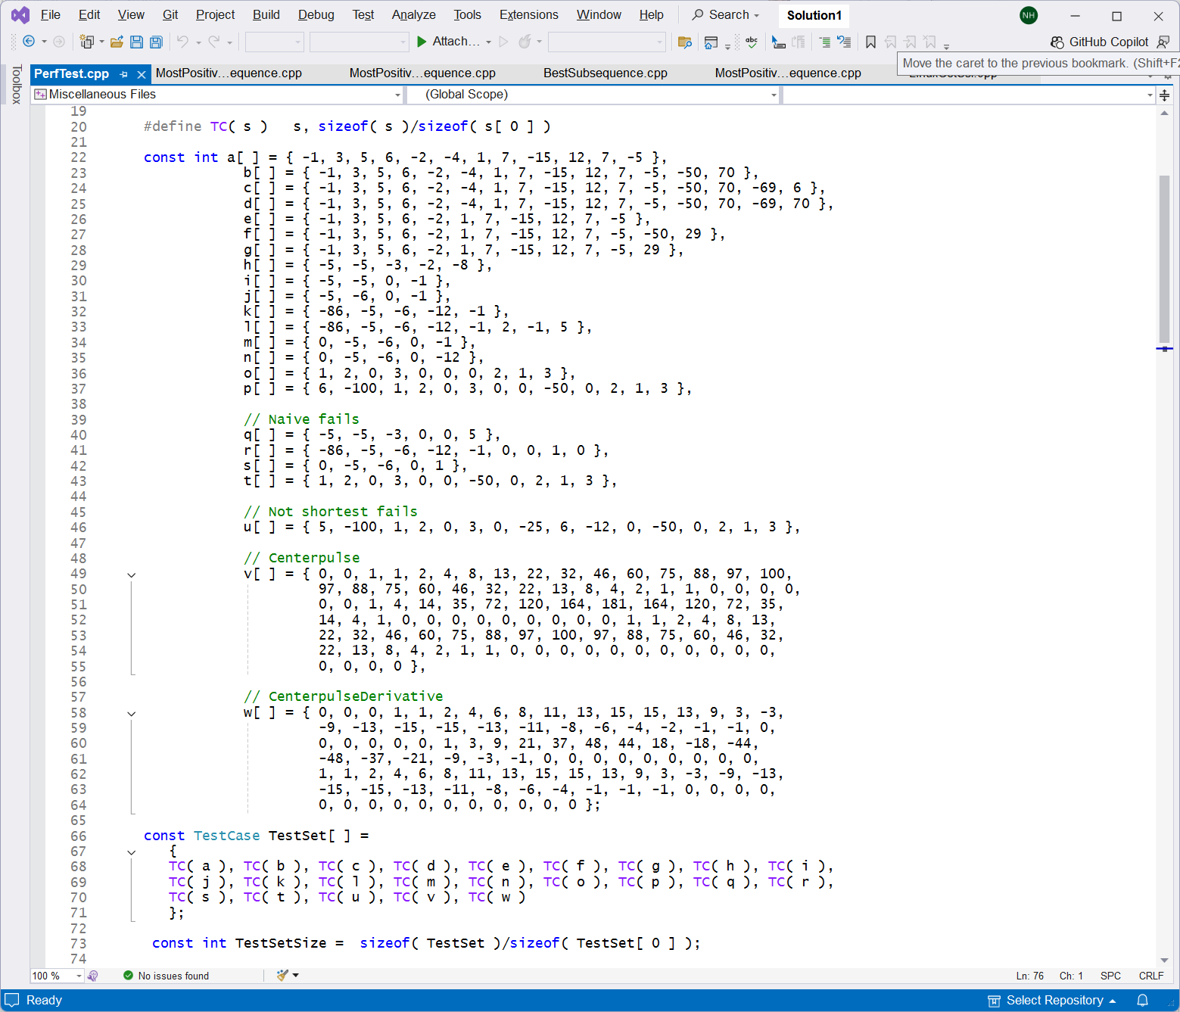

Slide 23
int ImprovedBenchmark( int a[ ], int n, int &bestL, int &bestR )
{
assert( n );
int sum, bestSum, L, R;
bestSum = a[ 0 ];
bestL = bestR = 0;
for ( L = R = sum = 0; R < n; )
{
sum += a[ R ];
if ( sum > bestSum ||
sum == bestSum && R - L < bestR - bestL )
{
bestL = L;
bestR = R;
bestSum = sum;
}
R++;
if ( sum <= 0 )
{
sum = 0;
L = R;
}
}
return bestSum;
}
Student ticks = 240777
Benchmark ticks = 304328
Ratio = 0.791176
Perf limit = 1.1
Performance is okay
Test succeeded

Slide 24
agenda
Course details
MostPositiveSubsequence
History of the web
Search basics
Your project

Slide 25
before the web
1970s Internal networks, mostly for email. Dial in for time sharing. 300 baud modems.
1980s USENET newsgroups. Posts were passed by polling from one machine to the next. 2400 baud modems.
1990s Bulletin boards, CompuServe, BIX, many others. 9600 baud modems.

Slide 26
Newsgroups: rec.humor
Path: gmd.de!xlink.net!sol.ctr.columbia.edu!news.kei.com!ub!acsu.buffalo.edu!ubvms.cc.buffalo.edu!v140pxgt
From: v140...@ubvms.cc.buffalo.edu (Daniel B Case)
Subject: Canonical List of Light Bulb Jokes
Message-ID: <CEr2F0.521@acsu.buffalo.edu>
News-Software: VAX/VMS VNEWS 1.41
Sender: nn...@acsu.buffalo.edu
Nntp-Posting-Host: ubvmsd.cc.buffalo.edu
Organization: University at Buffalo
Date: Mon, 11 Oct 1993 20:34:00 GMT
Lines: 1021
Sorry for the delay this month, but I had to clear some disk space to
post this (In the future, whenever I get there, I will be using Unix so this
won't happen-I hope). Anyway, here's the latest version.
:
:
https://groups.google.com/forum/?hl=en#!original/rec.humor/uRVacQrozNs/Qrmmizp8bUUJ

Slide 27
Newsgroups: rec.humor
Path: gmd.de!xlink.net!sol.ctr.columbia.edu!news.kei.com!ub!acsu.buffalo.edu!ubvms.cc.buffalo.edu!v140pxgt
From: v140...@ubvms.cc.buffalo.edu (Daniel B Case)
Subject: Canonical List of Light Bulb Jokes
Message-ID: <CEr2F0.521@acsu.buffalo.edu>
News-Software: VAX/VMS VNEWS 1.41
Sender: nn...@acsu.buffalo.edu
Nntp-Posting-Host: ubvmsd.cc.buffalo.edu
Organization: University at Buffalo
Date: Mon, 11 Oct 1993 20:34:00 GMT
Lines: 1021
Sorry for the delay this month, but I had to clear some disk space to
post this (In the future, whenever I get there, I will be using Unix so this
won't happen-I hope). Anyway, here's the latest version.
:
:
https://groups.google.com/forum/?hl=en#!original/rec.humor/uRVacQrozNs/Qrmmizp8bUUJ

Slide 28
Newsgroups: rec.humor
Path: gmd.de!xlink.net!sol.ctr.columbia.edu!news.kei.com!ub!acsu.buffalo.edu!ubvms.cc.buffalo.edu!v140pxgt
From: v140...@ubvms.cc.buffalo.edu (Daniel B Case)
Subject: Canonical List of Light Bulb Jokes
Message-ID: <CEr2F0.521@acsu.buffalo.edu>
News-Software: VAX/VMS VNEWS 1.41
Sender: nn...@acsu.buffalo.edu
Nntp-Posting-Host: ubvmsd.cc.buffalo.edu
Organization: University at Buffalo
Date: Mon, 11 Oct 1993 20:34:00 GMT
Lines: 1021
Sorry for the delay this month, but I had to clear some disk space to
post this (In the future, whenever I get there, I will be using Unix so this
won't happen-I hope). Anyway, here's the latest version.
:
:
https://groups.google.com/forum/?hl=en#!original/rec.humor/uRVacQrozNs/Qrmmizp8bUUJ

Slide 29
the web is born
Aug 6, 1991, the WWW goes live.
1993 Mosaic browser introduced.
1994, WebCrawler and Lycos go live.

Slide 30
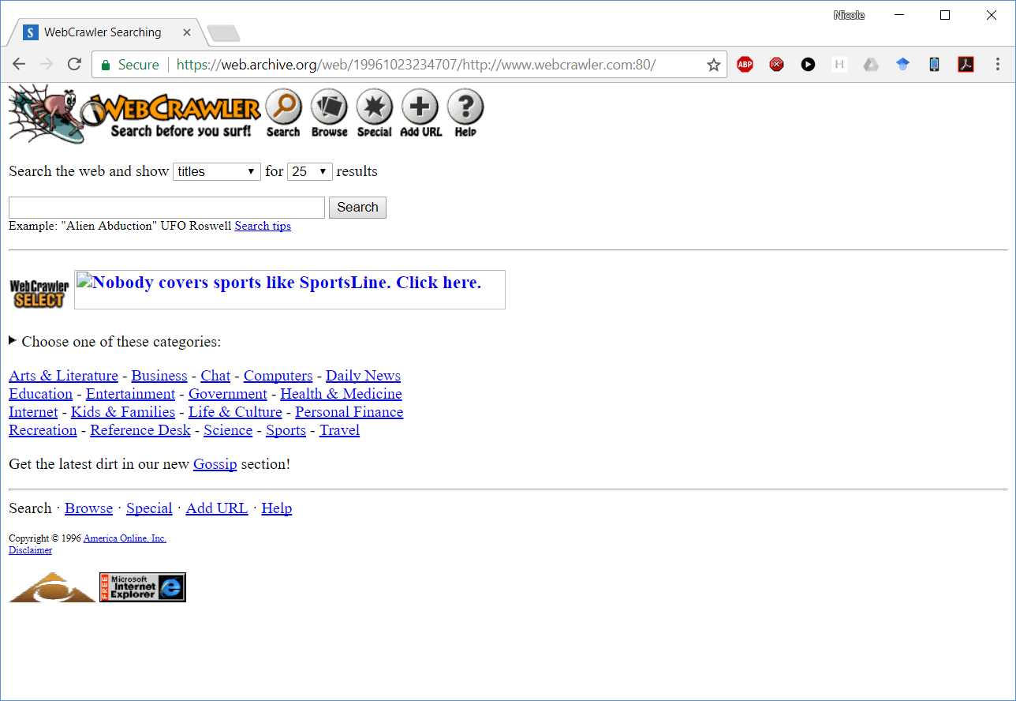

Slide 31
web surfing is born
Through the 90s, individuals and companies post pages with quirky links.
Web surfing begins.

Slide 32
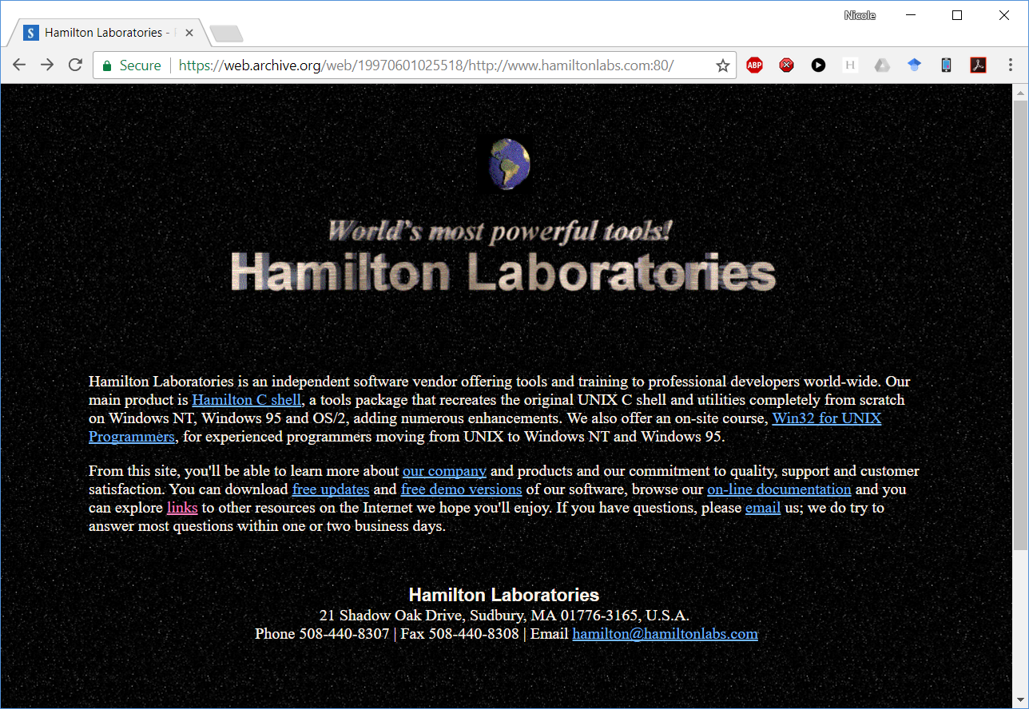
https://web.archive.org/web/19970601025518/http://www.hamiltonlabs.com:80/

Slide 33
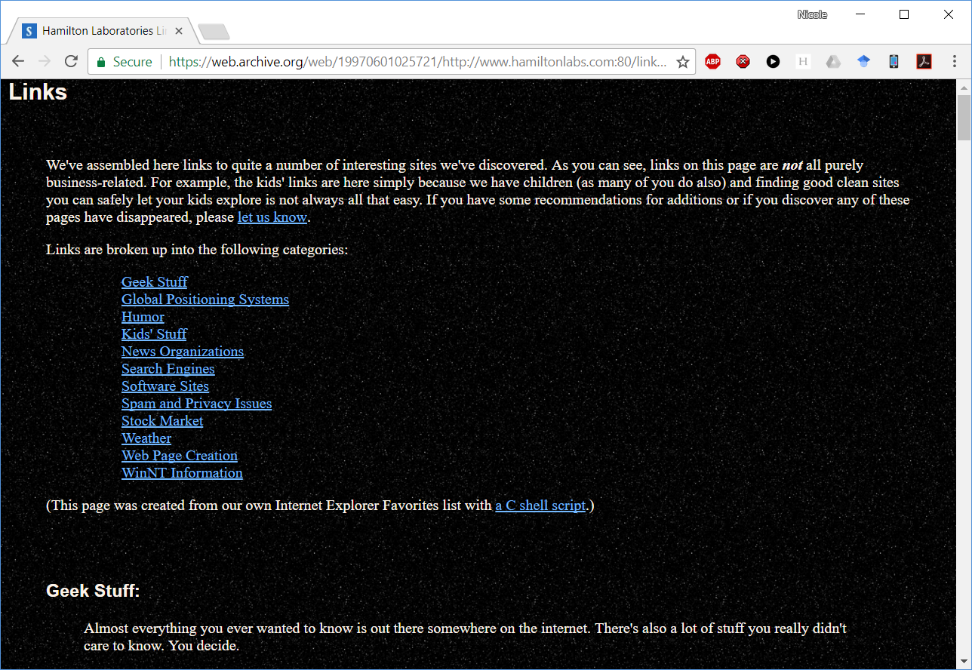

Slide 34
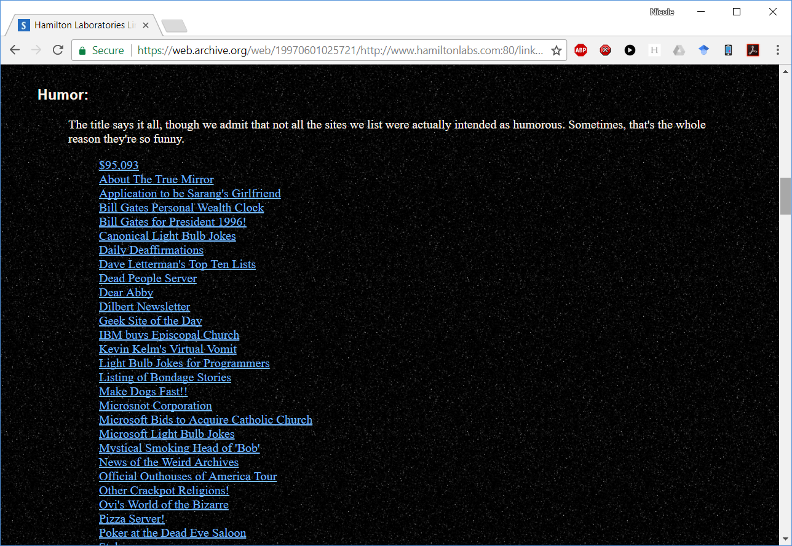

Slide 35
Yahoo!
Mar 2, 1995, Yahoo! goes live but their links are all hand-curated.

Slide 36
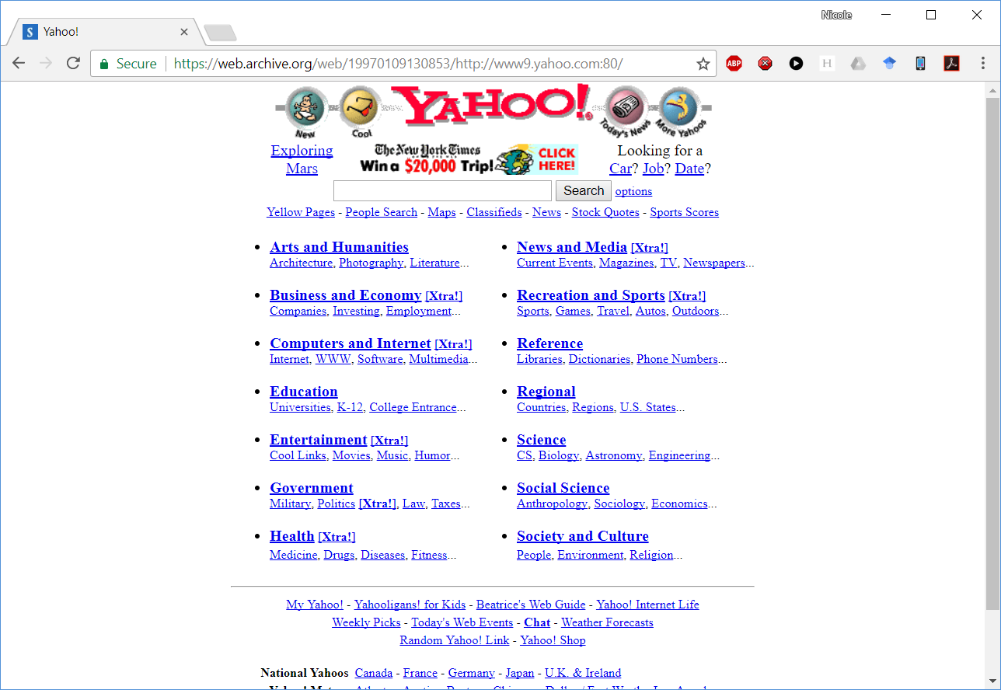

Slide 37
Yahoo!
Jerry Yang and David Filo, both PhD students in engineering at Stanford, start Jerry’s Guide to the Web.
Jerry hated the name, so it became Yahoo!, a meaningless acronym.
Hand-crafted directory to the web.
Jerry and David categorized 1000 sites/day.
Initially running out of a trailer on campus.
Moved to free hosting on Netscape’s machines in early 1995.
“It was a labor love – lots of labor, since no software program could evaluate and categorize sites.”

Slide 38
AltaVista
Dec 15, 1995, DEC Research’s AltaVista goes live with the first modern search engine architecture.
Used index stream readers invented by Mike Burrows.
AltaVista quickly becomes most popular engine.
Bought by Yahoo! in 2003.

Slide 39
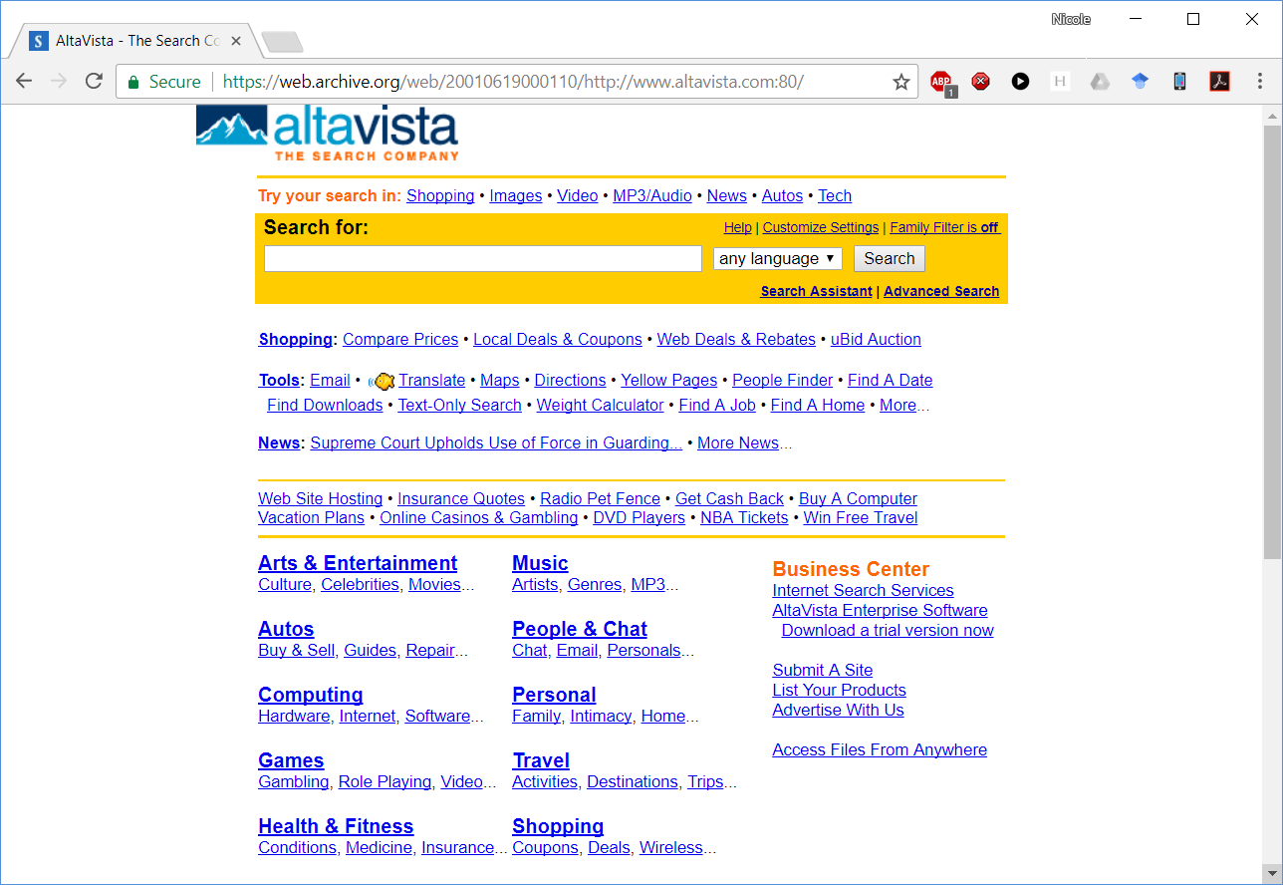

Slide 40
Google
Sep 4, 1998, Google goes live with PageRank, named after Larry Page, coinvented by Sergey Brin.
Introduced a much simpler page where they promised that all their results were algorithmic, none paid and that they would do no evil.
Quickly became the dominant engine.

Slide 41
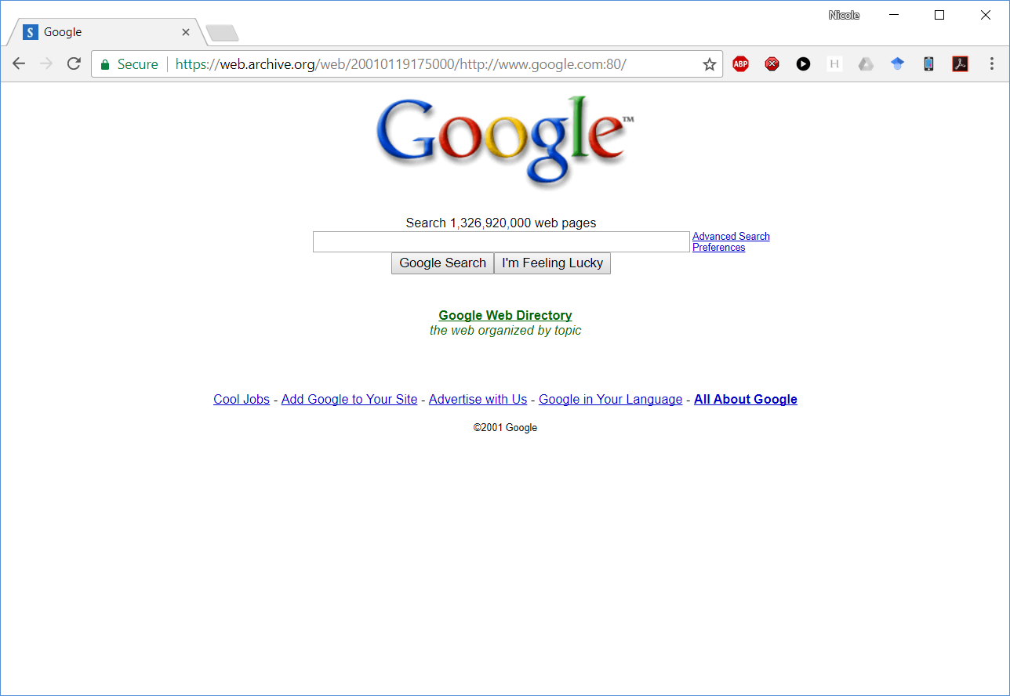

Slide 42
Why did this become dominant?

Slide 43
Bing
Jan 2005, Microsoft’s own engine goes live, initially as MSN Search.

Slide 44
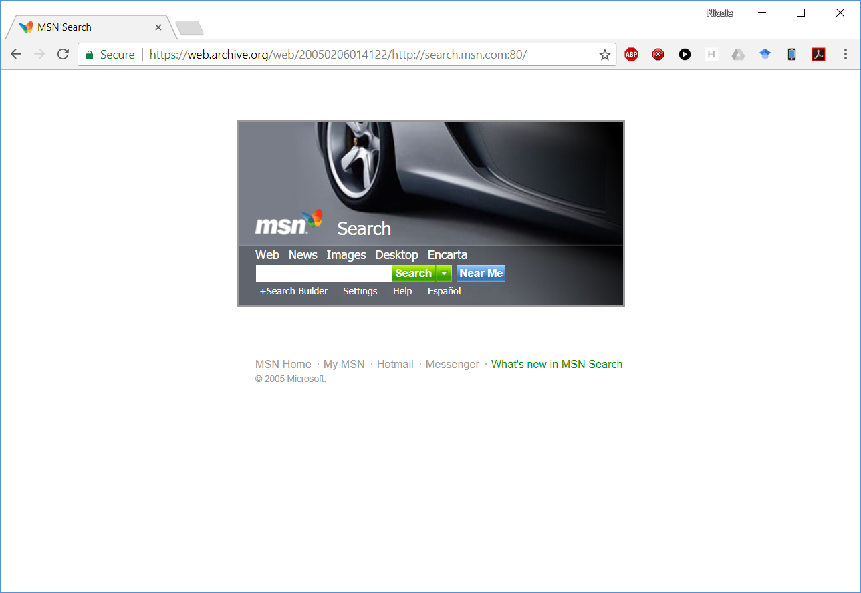

Slide 45
It’s a lot easier to do something if you know it’s possible.
In business, this called either an imitator or follower strategy.
In engineering, if you know something’s possible, you know not to give up.

Slide 46
agenda
Course details
MostPositiveSubsequence
History of the web
Search basics
Your project

Slide 47
the basic parts to a search engine
HTML parser.
Crawler.
Index.
Constraint solver.
Query language.
Ranker.
Front end.

Slide 48
the index build side
Seed list
Crawler
HTML parser
Index build
Index files

Slide 49
the index build side
Seed list
Crawler
HTML parser
Index build
Index files

Slide 50
the query serve side
Queries
Front end
Query compiler
Constraint solver
Ranker
Results
Index server
Index files

Slide 51
the query serve side
Queries
Front end
Query compiler
Constraint solver
Ranker
Results
Index server
Index files

Slide 52
HTML Parser
Seed list
Crawler
Extract the content from a HTML file as a series of tokens in the title and the body of the document and a set of links with anchor text to other documents.
HTML parser
Index build
Index files

Slide 53
HTML Parser
Seed list
Crawler
Historically, many teams have found that getting the HTML parser to work is the most time-consuming part of the project.
There is so much bad, broken HTML out there on the web that many teams struggle to keep their parsers from crashing.
This is a big part of the surface area of your project.
HTML parser
Index build
Index files

Slide 54
HTML Parser
Seed list
Crawler
Common pitfall: Overengineering and overcomplexity.
Think carefully: What does it need to do?
Does it need to parse the entire document structure?
You have a homework that should help point you in the right direction.
HTML parser
Index build
Index files

Slide 55
HTML
<!DOCTYPE html PUBLIC "-//W3C//DTD XHTML 1.0 Strict//EN"
"http://www.w3.org/TR/xhtml1/DTD/xhtml1-strict.dtd">
<html xmlns="http://www.w3.org/1999/xhtml">
<head>
<meta content="text/html; charset=utf-8" http-equiv="Content-Type" />
<title>Page title shown in the browser tab</title>
<script>Lots of gibberish</script>
<link href="MyStyles.css" rel="stylesheet" type="text/css" />
<link href="https://mydomain/favicon.ico" rel="shortcut icon" />
<meta name="DC.Rights" content="Copyright 2018 my name"/>
<meta name="description" content=“Short abstract."/>
<meta name="keywords" content=“arbitrary list of words"/>
</head>
<body>
:
</body>
</html>

Slide 56
crawler
Seed list
Crawler
Manage a frontier of new links to be crawled.
Decide what will or will not be crawled and in what order.
Keep track of what’s already been crawled.
Read pages over HTTP and HTTPS.
Obey robots.txt files.
Deal with redirects.
HTML parser
Index build
Index files

Slide 57
crawler
Seed list
Crawler
All of this has to be highly multithreaded so you don’t wait on slow sites, instead overlapping them.
You will also want to spread it across multiple machines and will need to decide how to divide it up and pass information.
This also is part of your surface area.
HTML parser
Index build
Index files

Slide 58
crawler
Seed list
Crawler
Typically maintains pool of worker processes or threads to read and parse webpages.
Each worker retrieves the file and queues it for the HTML parser which creates an object.
Links go into the frontier, perhaps with anchor.
Words go into the index.
HTML parser
Index build
Index files

Slide 59
crawler
Seed list
Crawler
It’s very easy to DOS a site with thousands of threads on a bunch of AWS machines with gigabit connections.
So, we’ll talk about politeness and putting your contact info in your User-Agent: field so complaints go to you, not me.
HTML parser
Index build
Index files

Slide 60
index
Seed list
Crawler
A merged inverted word index of all the documents that have been crawled, allowing you to report all the documents and individual locations (postings) where any given word was found.
Due to the size, the posting lists will have to be on disk but you’ll map them right into your process virtual memory address space.
HTML parser
Index build
Index files

Slide 61
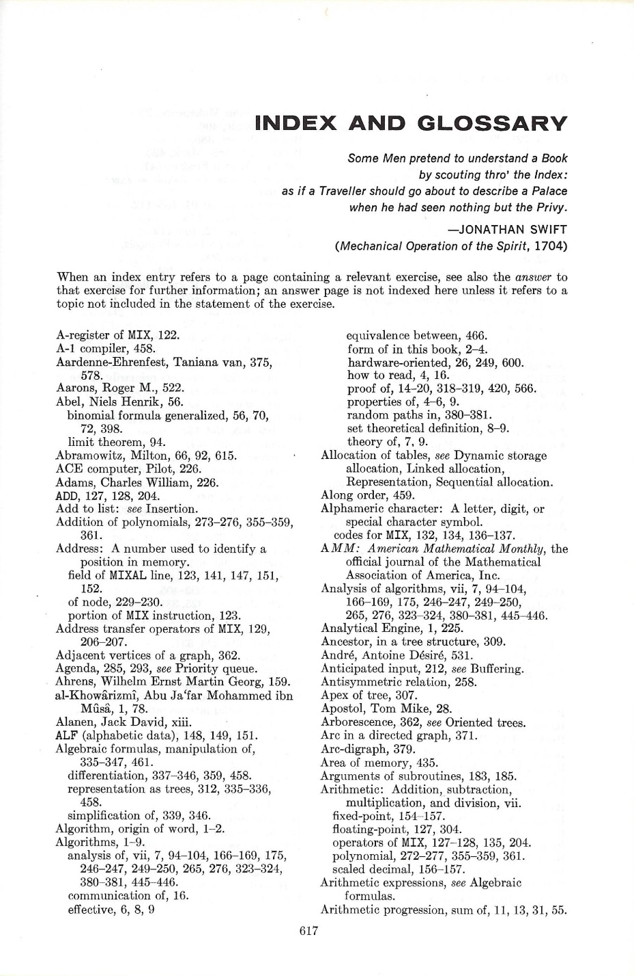
The inverted word index operates like the index at the back of a book.
An index in a book lists all pages where a word or topic appears.
It’s called inverted because we think of the original text as the non-inverted form.

Slide 62
If you want to know the list of pages where some combination of topics appears, all you need to do is find the intersections of the lists.

Slide 63
An inverted word list is a computer scientist’s term for an older idea.

Slide 64
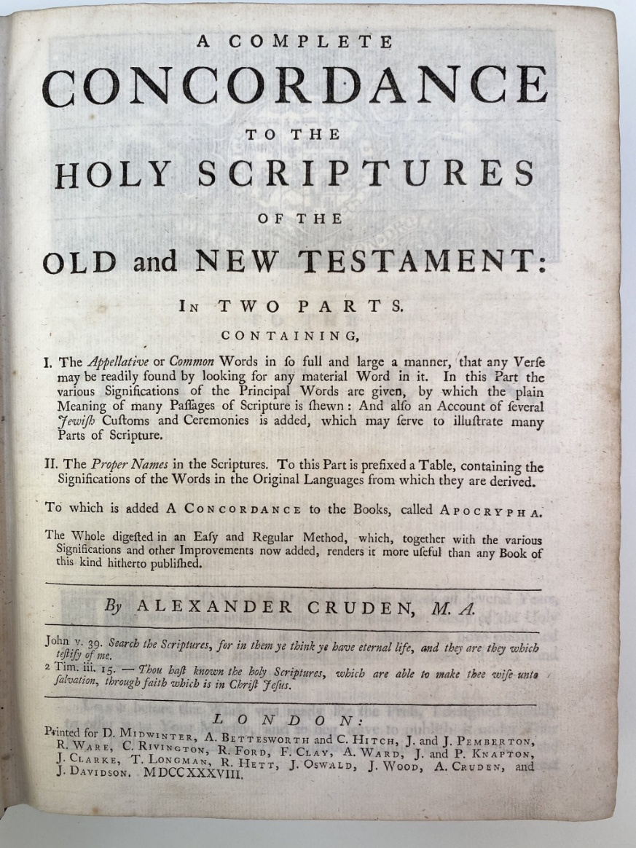
Historically, concordances have been used to search important works.
A concordance is an alphabetical list of the words used in a book or body of work, listing every instance with its immediate context.
Image source: https://www.historyofinformation.com/detail.php?id=3045

Slide 65
The first Bible concordance was compiled for the Vulgate Bible by Hugh of St Cher (d.1262), who employed 500 friars to assist him.
The audience was priests preparing sermons.
Image source: https://www.historyofinformation.com/detail.php?id=3045

Slide 66
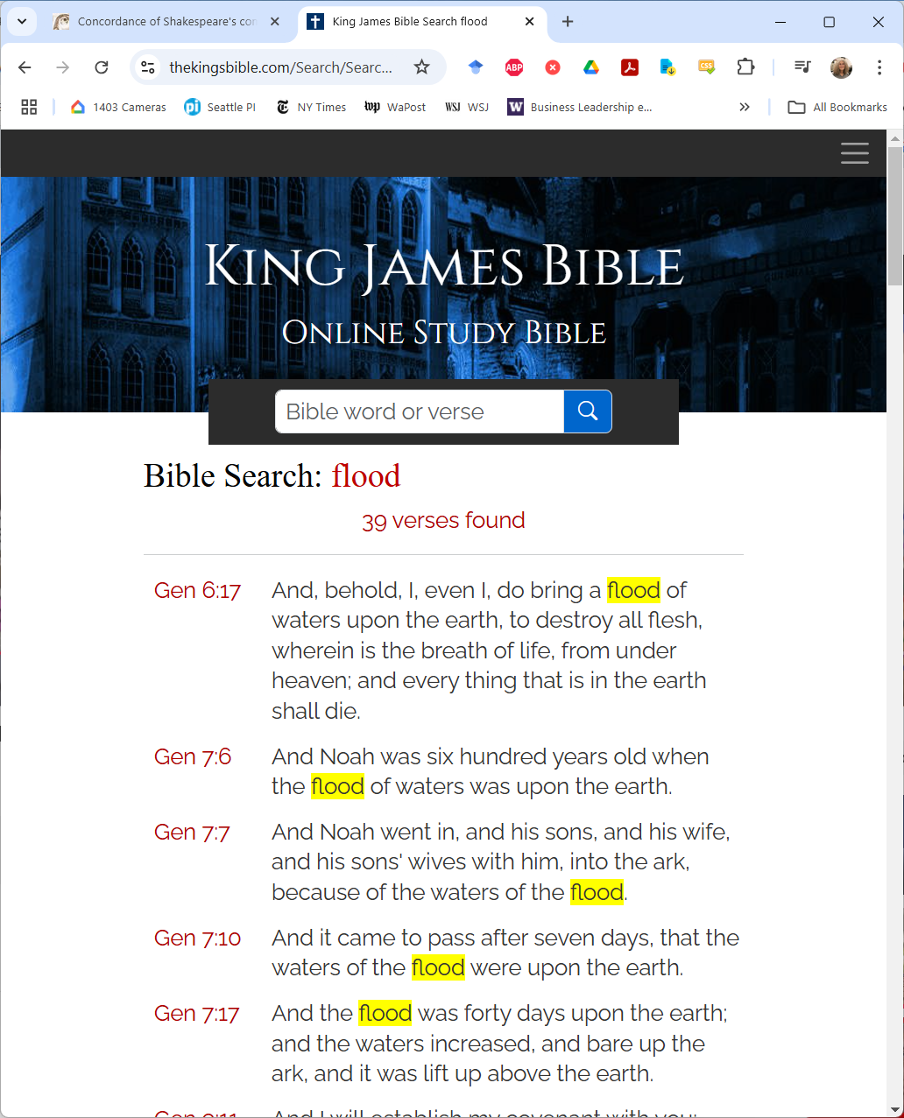
Here’s how an online Bible concordance works.
Notice how it gives the context. For the Bible, that’s the whole verse.
https://thekingsbible.com/Search/SearchResults

Slide 67

Concordances have also been created for the Vedas, Qur’an, the works of Shakespeare and other authors.
Before computers, they had to be constructed by hand. So, they were only done for important works.
This one is 1000 pages.

Slide 68
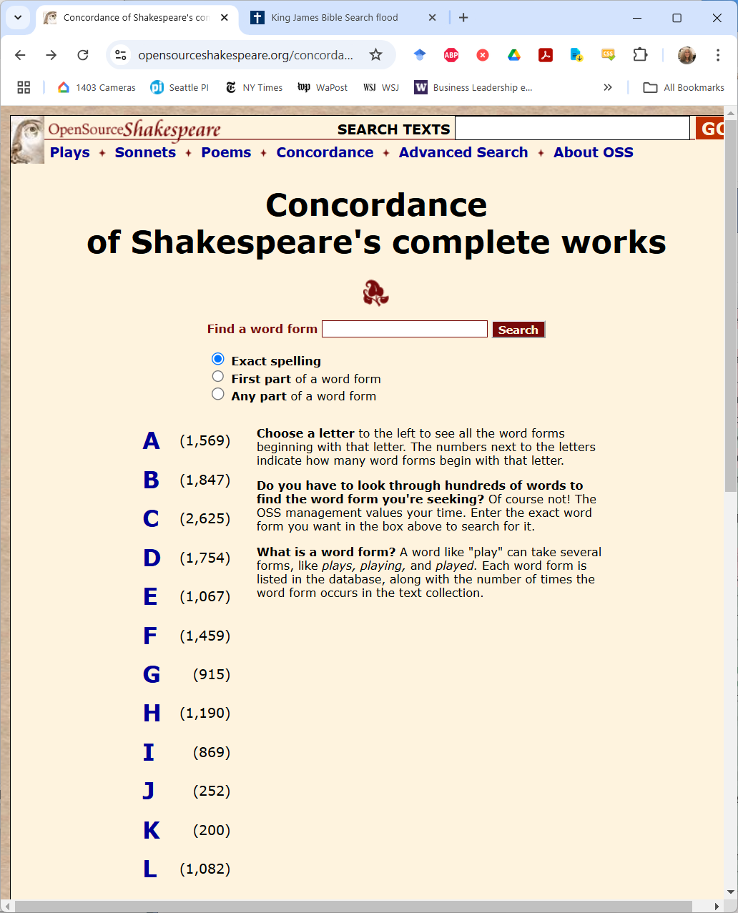
Here’s how an online Shakespeare concordance.
https://www.opensourceshakespeare.org/concordance/

Slide 69
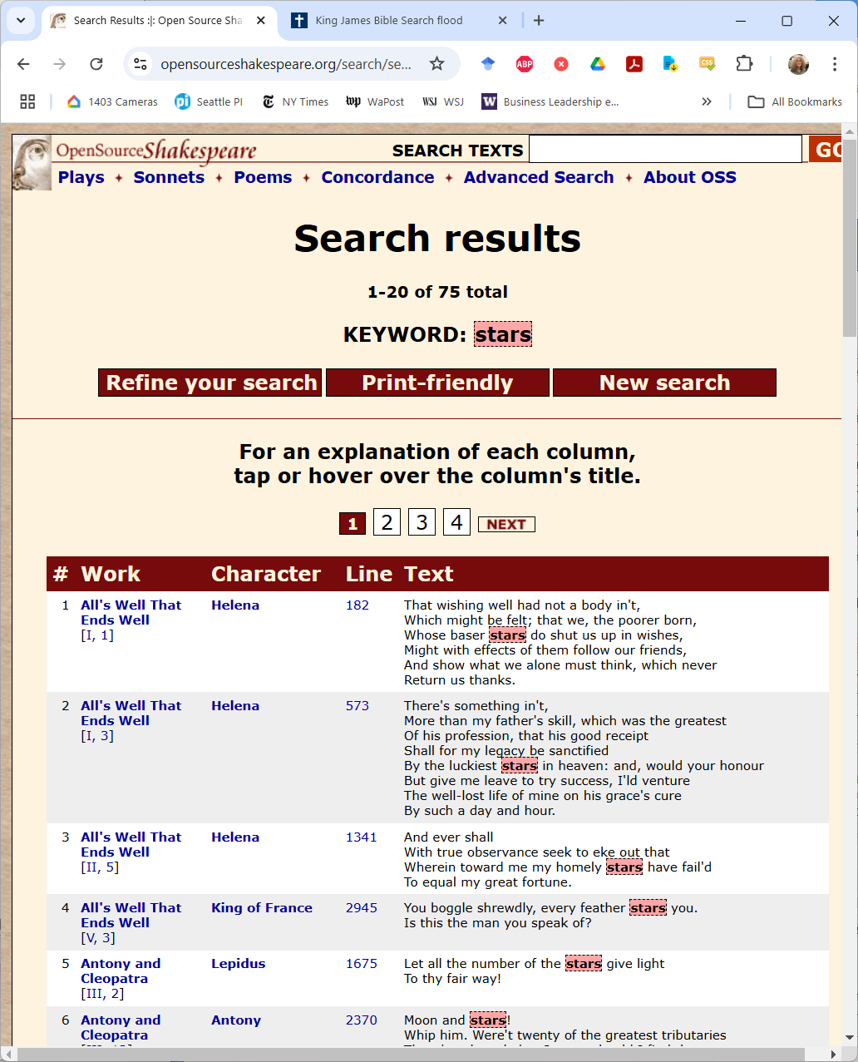
If I search for stars, I can find all the lines that mention stars and who said it.
https://www.opensourceshakespeare.org/concordance/

Slide 70
In your search engine you’ll create an index as file containing the list of URLs contained in the index and the inverted word index.
List of URLS
Inverted word index

Slide 71
The inverted word index
Dictionary
Posting list
Posting list
Posting list
…
Posting list
A posting list
Common Header
Type-specific data
Index
Post
Post
Post
…
Sentinel
An individual post
Delta from previous post
Type-specific data

Slide 72
constraint solver
Queries
Front end
Given an inverted word index and a constraint, e.g., a list of words that must appear together or as a phrase in a document, find the list of matching documents.
Query compiler
Constraint solver
Ranker
Results
Index server
Index files

Slide 73
constraint solver
Queries
Front end
Index Stream Readers (ISRs) are used to scan the index.
Finds the next occurrence of the desired token or combination of child ISRs representing individual words, document ends, ORing or ANDing of terms, Phrases, and Nots (terms that should not occur in the document.)
Query compiler
Constraint solver
Ranker
Results
Index server
Index files

Slide 74
Consider these posting lists
quick 10 27 105 513 518 520
brown 28 50 62 70 514 790
fox 87 106 515 550 1200
#DocEnd 112 570 1006 1704
To read and merge these lists, we need to move from one entry to the next.
We'll do that with an ISR (index stream reader).
The ISR for each token has to be able to report its current location and any attributes, and it needs Next( ) and Seek( ) functions.

Slide 75
OR'ing streams
quick 10 27 105 513 518 520
brown 28 50 62 70 514 790
fox 87 106 515 550 1200
#DocEnd 112 570 1006 1704
quick | fox 10 27 87 105 106 513 515 518 520
An OR ISR simply merges the streams.
No need to pay attention to document boundaries. Each post is in whichever posting list and whatever document it happens to be.

Slide 76
AND'ing streams
quick 10 27 105 513 518 520
brown 28 50 62 70 514 790
fox 87 106 515 550 1200
#DocEnd 112 570 1006 1704
quick fox ?

Slide 77
AND'ing streams
Easier to consider if we show the document boundaries.
quick 10 27 105 513 518 520
brown 28 50 62 70 514 790
fox 87 106 515 550 1200
#DocEnd 112 570 1006 1704
quick fox ?
AND'ing of terms should find occurrences of all the terms within a single document.

Slide 78
query compiler
Queries
Front end
Compile a query as typed, e.g., with quotes around phrases, into a structure the constraint solver understands.
Query compiler
Constraint solver
Ranker
Results
Index server
Index files

Slide 79
The query language and the ISRs should be recursive
"apollo moon landing" | ( apple banana )
OR
The parse tree
Phrase
AND
"apollo"
"moon"
"landing"
"apple"
"banana"

Slide 80
ranker
Queries
Front end
Use the compiled query to retrieve matching pages from the index, then score them by a statistical, heuristic or other method and pick the ten best.
Query compiler
Constraint solver
Ranker
Results
Index server
Index files

Slide 81
front end
Queries
Front end
Report the results back, possibly including snippets with a simple HTTP server.
Query compiler
Constraint solver
Ranker
Results
Index server
Index files

Slide 82
Result quality
To be useful as a search engine, it must produce good results quickly.

Slide 83
result quality
Traditional measures:
Precision The fraction of the results that are relevant.
Recall The fraction of all relevant results returned.

Slide 84
result quality
And because it matters that the top results be the best:
Relevance An estimate of the overall quality of the page as an result for this query that can be used for ranking (ordering) the results.

Slide 85
kinds of rank
Dynamic rank How good a match this page is to this specific query.
Static rank How good the page is, knowing nothing about the query.

Slide 86
dynamic rank
Estimate the quality of match between the page and the query.
Traditional methods in information retrieval considered the page as a bag of words and ostensibly measured the mathematical or statistical similarity.
For example, one method claimed to consider the document and the query as vectors and to calculate the angle between them.

Slide 87
bag of words
A scoring method that considers only that the search words occur in the document, not where or in what relation to each other.

Slide 88
tf-idf
Term-frequency, inverse document frequency.
Easily the most famous bag of words technique. The more occurrences of a rare word, the better.

Slide 89
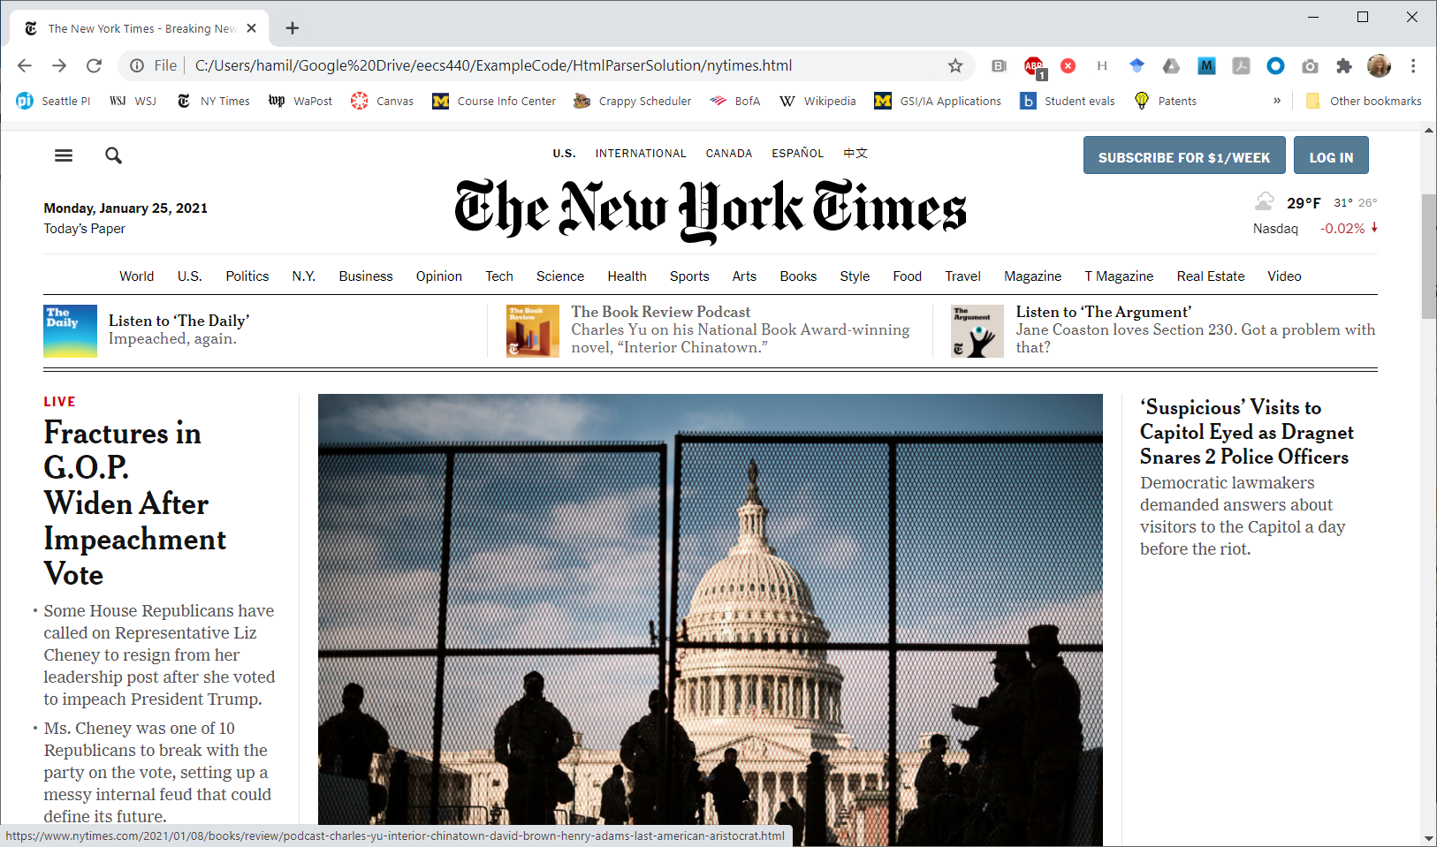
bag of words
Here’s a sample NY Times page from Jan 25, 2021.

Slide 90
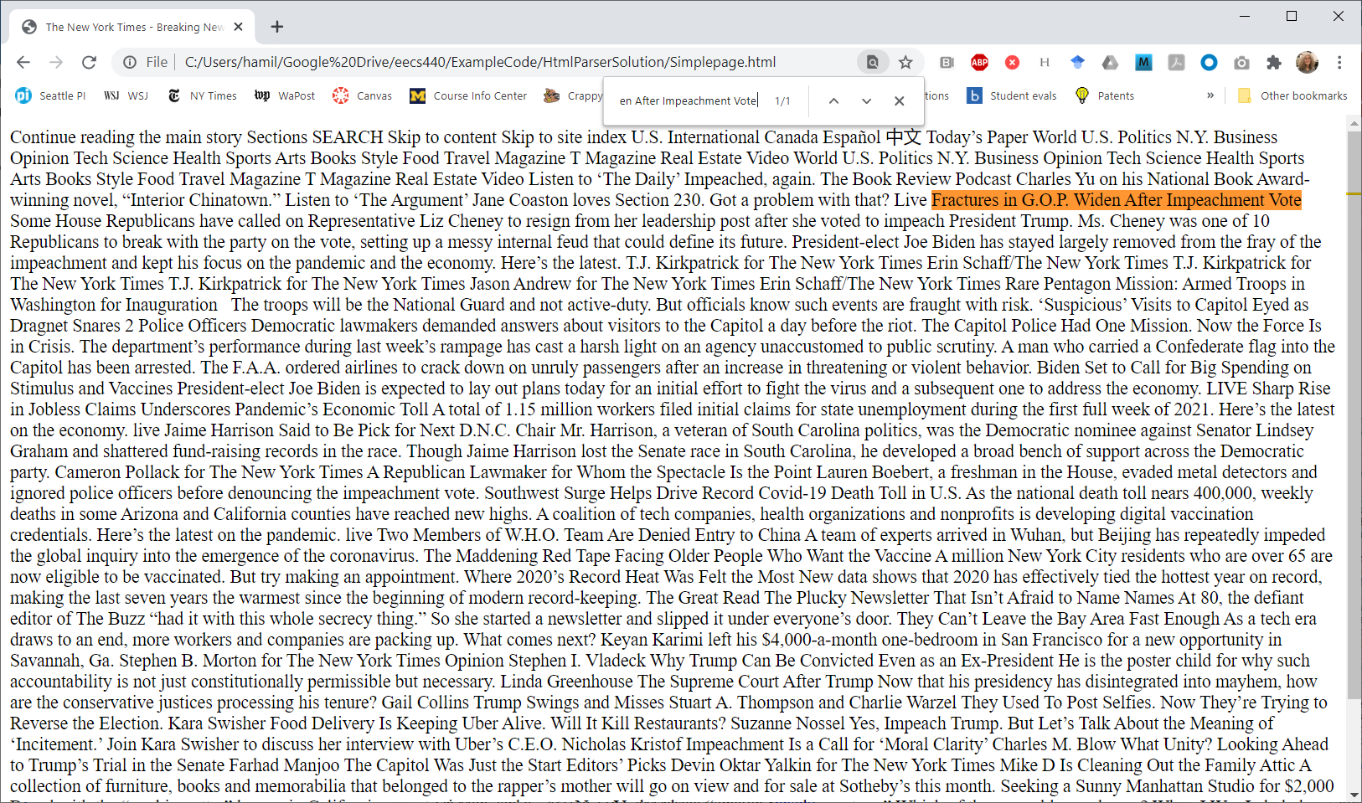
bag of words
Here it is stripped of HTML and CSS but the text remains.

Slide 91
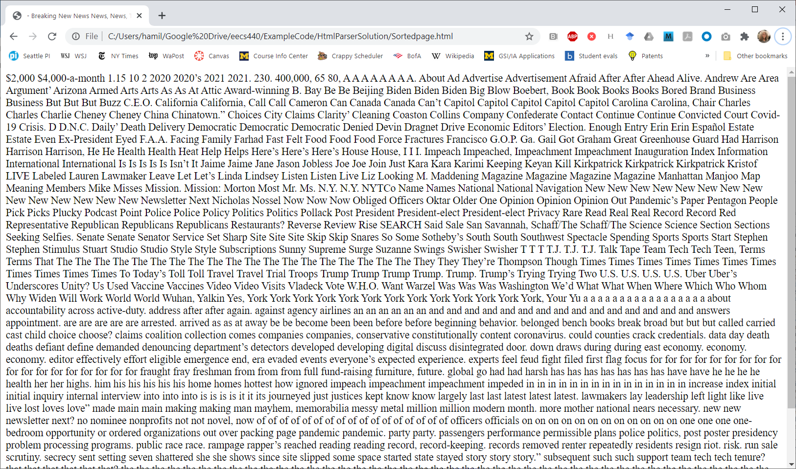
bag of words
Here it is with the words in the title and body sorted. Tf-idf can’t tell the difference.

Slide 92
at Microsoft
At Microsoft, we separated the occurrences into four metastreams, in order of importance.
Anchor text.
URL.
Title.
Body text.

Slide 93
heuristics
Pick the rarest word in the query, then iterate over its occurrences on the page.
At each place, move the pointers to the other words to as close to the correct relative position as possible.
Score that that set, called a span, counting the number of spans, the number of exact phrases, in order, close together, etc.
Score the counts, weighting exact phrases the title as more important than other matches.

Slide 94
heuristics
Altogether, had about 700 heuristics in a linear combination.
Tuned them using gradient descent and approximately 150K labeled pages and queries.

Slide 95
what we found
Finding the search words in the right order and close together was more important than simply finding lots of them.
Added tf-idf because under pressure that of course we should consider it. Removed it because it added nothing to our relevance but slowed our crawl.
It mattered a lot where we found the matching terms.
Anchor > URL > Title > Body text

Slide 96
static rank
Some pages are just better than others before you know anything about the query.

Slide 97
static rank
Some domains are better than others, e.g., .gov or .edu over .biz.
Short URLs are better.
Short titles are probably better.
Some pages may be obvious spam.
Some pages may have lots of other pages pointing to them, e.g., PageRank.

Slide 98
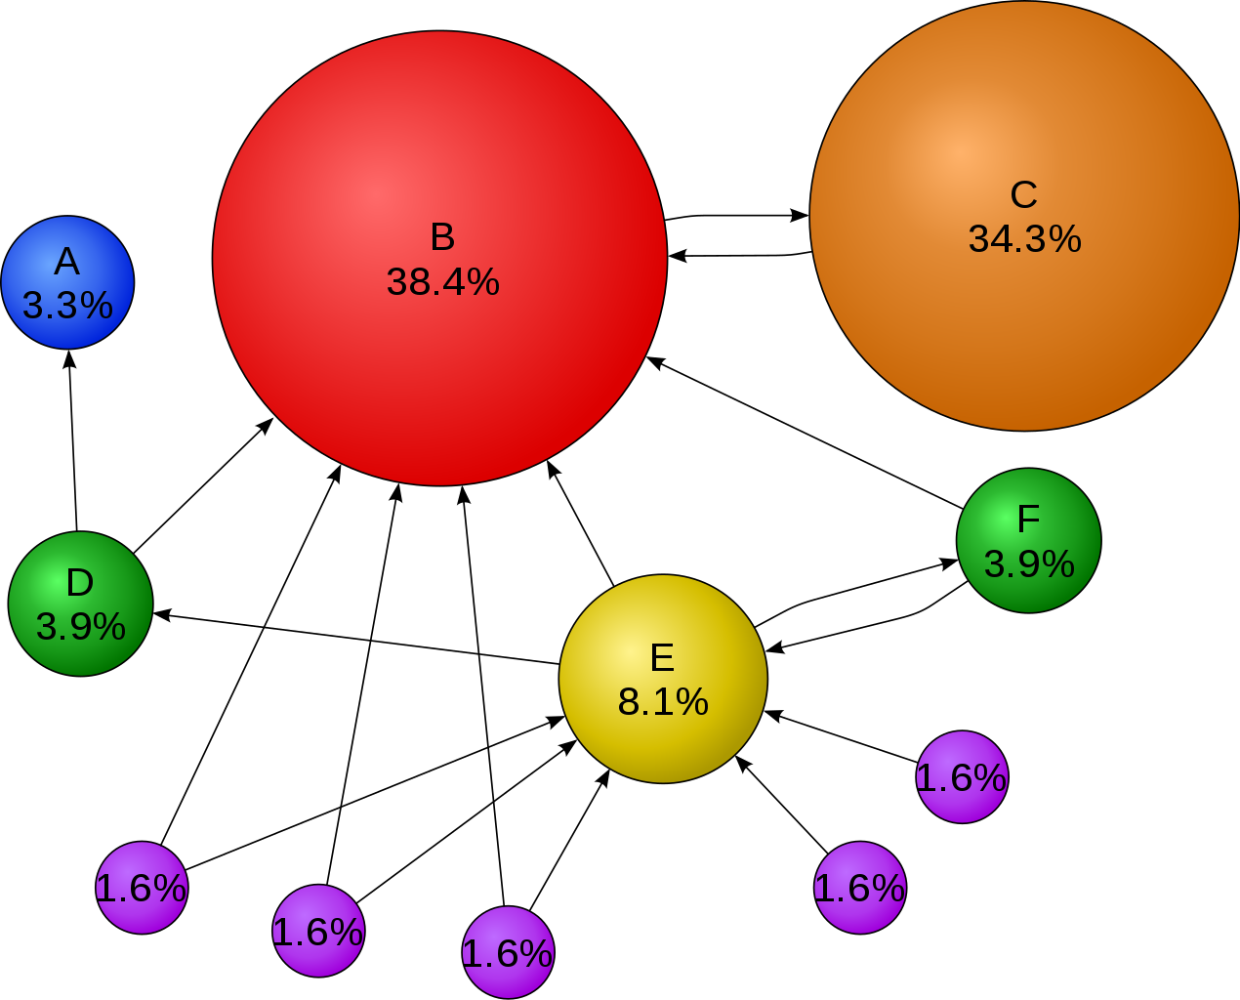
PageRank
The basic idea: The more and better links to a page, the more likely it should rank higher.
Image source: https://upload.wikimedia.org/wikipedia/commons/thumb/f/fb/PageRanks-Example.svg/1270px-PageRanks-Example.svg.png

Slide 99
PageRank
It obviously did work and they got better results.
It also gave halo of special legitimacy to their results, that they were scientific and unbiased.

Slide 100
at Microsoft
We gamely expected our version of PageRank to represent about half the overall rank value, largely based on the hype around it.
Turned out it was very expensive to calculate and represented only a small part of the final rank score.

Slide 101
Agenda
Course details.
HW1 MostPositiveSubsequence( ).
History of the web.
Search basics.
Your project.

Slide 102
your project
I’ve broken it into 8 levels of functionality:
0 Basic plan for your project.
Parse text files into a hash table.
Build a crawler.
Build a reverse word index.
Create a user interface.
Build a constraint solver and query parser.
Build a ranker.
Advanced functionality.

Slide 103
next
Overall course plan is:
Cover the OS topics you’ll need.
Get you crawling ASAP.
Work through each piece in order and in time for you to get it done.
Next time: Project planning.
Who needs a team?

